Slide 1
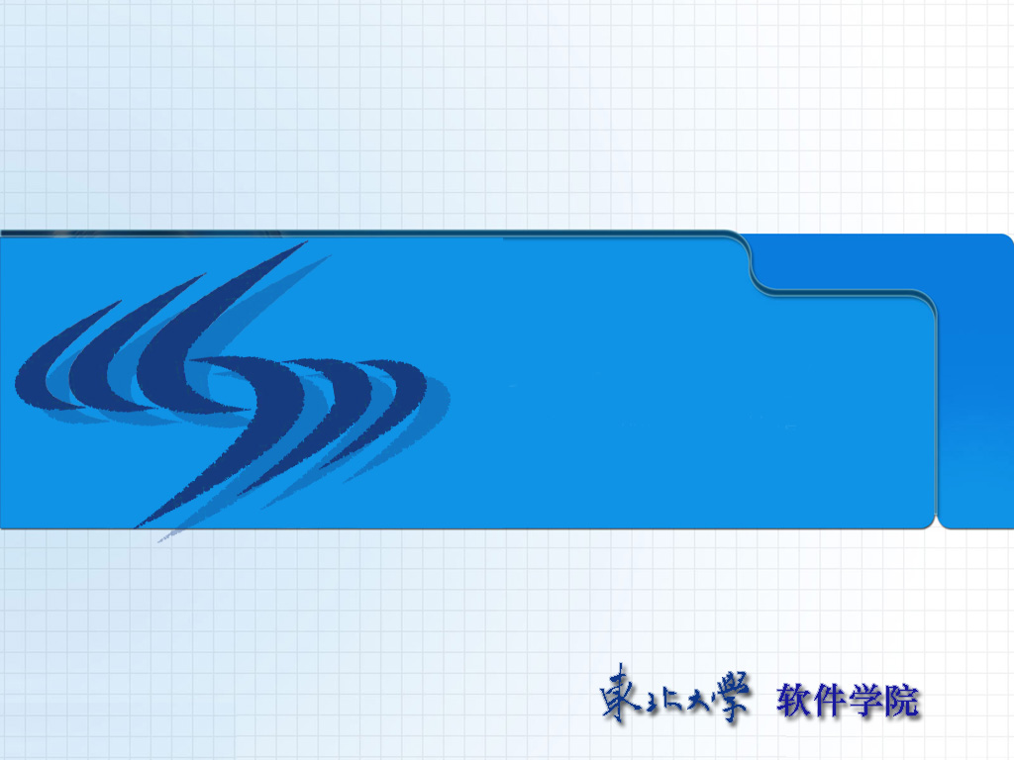
Principles of
Operating System
I/O System

Slide 2


Roadmap
Application I/O Interface
Kernel I/O Subsystem
Transforming I/O Requests to Hardware Operations
Performance

Slide 3
Overview
The control of devices connected to the computer is a major concern of operating system designers
Two conflicting trends
  Increasing standardization of software and hardware interfaces
  An increasingly broad variety of I/O devices

Slide 4
Device Driver
To encapsulate the details and oddities of different devices, the kernel of an operating system is structured to use device driver modules
Device drivers present a uniform device-access interface to the I/O subsystem
  much as system calls provide a standard interface between the application and the operating system

Slide 5

I/O Hardware
Common concepts
  Port
  Bus (daisy chain or shared direct access)
  Controller (host adapter)

Slide 6
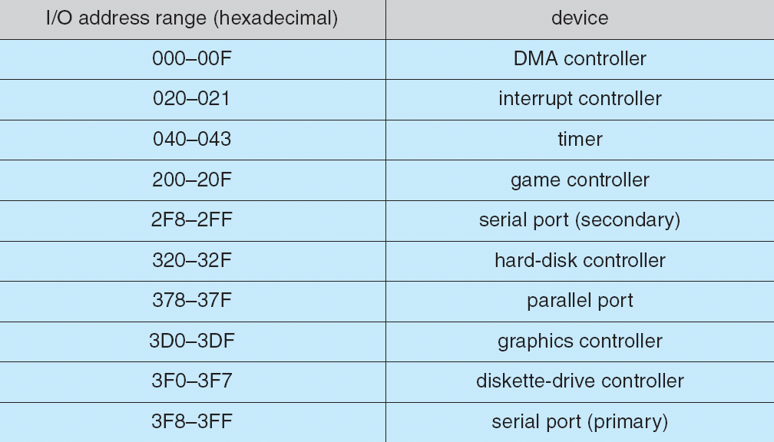
I/O Hardware (cont.)
I/O instructions control devices
Devices have addresses, used by
  Direct I/O instructions
  Memory-mapped I/O

Slide 7
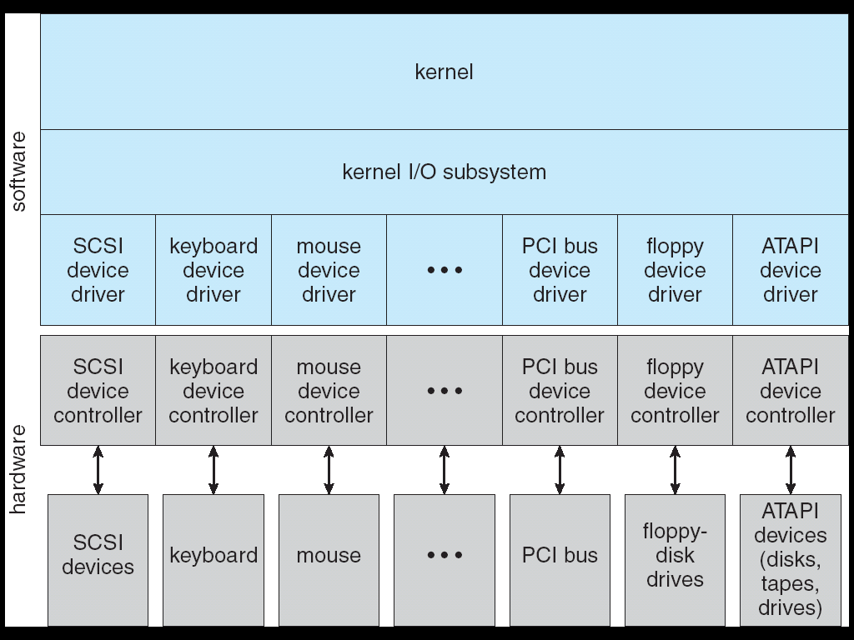
Application I/O Interface
I/O system calls encapsulate device behaviors in generic classes
Device-driver layer hides differences among I/O controllers from kernel

Slide 8
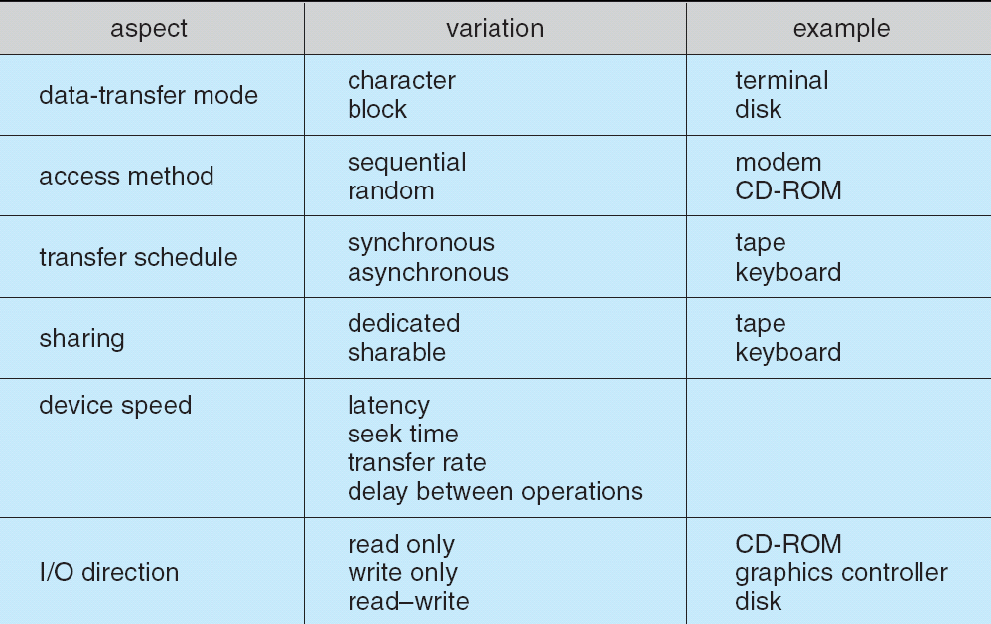
Application I/O Interface
Devices vary in many dimensions
  Character-stream or block
  Sequential or random-access
  Sharable or dedicated
  Speed of operation
  read-write, read only, or write only

Slide 9
Block and Character Devices
Block devices include disk drives
  Commands include read, write, seek
  Raw I/O or file-system access
  Memory-mapped file access possible
Character devices include keyboards, mice, serial ports
  Commands include get, put
  Libraries layered on top allow line editing

Slide 10
Network Devices
Varying enough from block and character to have own interface
Unix and Windows NT/9i/2000 include socket interface
  Separates network protocol from network operation
  Includes select functionality
Approaches vary widely (pipes, FIFOs, streams, queues, mailboxes)

Slide 11
Clocks and Timers
Provide current time, elapsed time, timer
If programmable interval timer used for timings, periodic interrupts

Slide 12
Blocking and Nonblocking I/O (1/2)
Blocking: process suspended until I/O completed
  Easy to use and understand
  Insufficient for some needs
Nonblocking: I/O call returns as much as available
  User interface, data copy (buffered I/O)
  Implemented via multi-threading
  Returns quickly with count of bytes read or written

Slide 13
Blocking and Nonblocking I/O (2/2)
Asynchronous: process runs while I/O executes
  Difficult to use
  I/O subsystem signals process when I/O completed
Nonblocking I/O example:
  "select" system call

Slide 14
Roadmap
Application I/O Interface
Kernel I/O Subsystem
Transforming I/O Requests to Hardware Operations
Performance

Slide 15
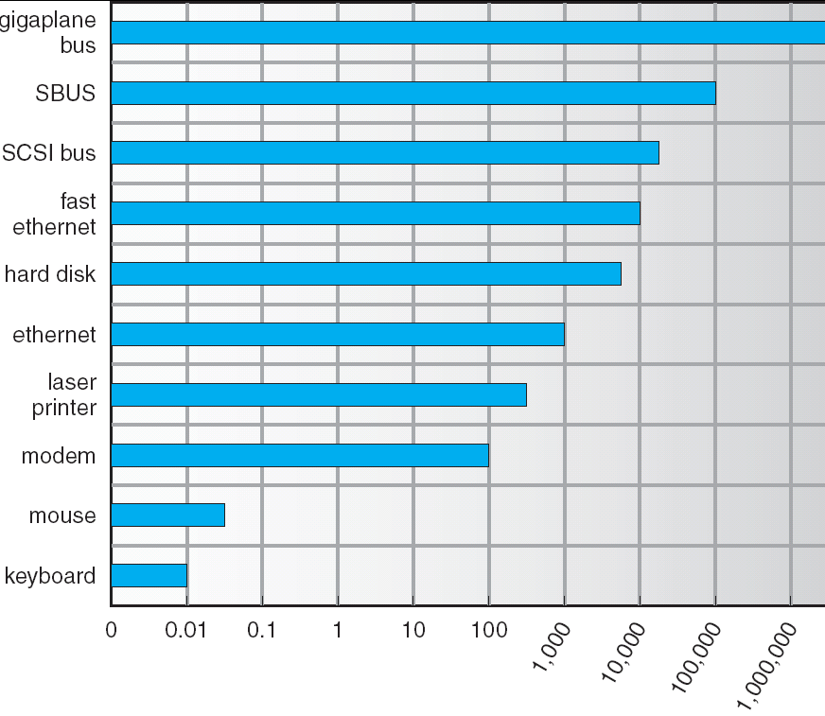
Kernel I/O Subsystem
Scheduling
  Some I/O request ordering via per-device queue
  Some OSs try fairness
Buffering: store data in memory while transferring between devices
  To cope with device speed mismatch
  To cope with device transfer size mismatch
  To maintain “copy semantics”

Slide 16
Kernel I/O Subsystem
Caching: fast memory holding copy of data
  Always just a copy
  Key to performance
Spooling: hold output for a device
  If device can serve only one request at a time, i.e., Printing
Device reservation: provides exclusive access to a device
  System calls for allocation and deallocation
  Watch out for deadlock

Slide 17
Error Handling
OS can recover from disk read, device unavailable, transient write failures
Most return an error number or code when I/O request fails
System error logs hold problem reports

Slide 18
Kernel Data Structures
Kernel keeps state info for I/O components, including open file tables, network connections, character device state
Many complex data structures to track buffers, memory allocation, “dirty” blocks
Some use object-oriented methods and message passing to implement I/O

Slide 19
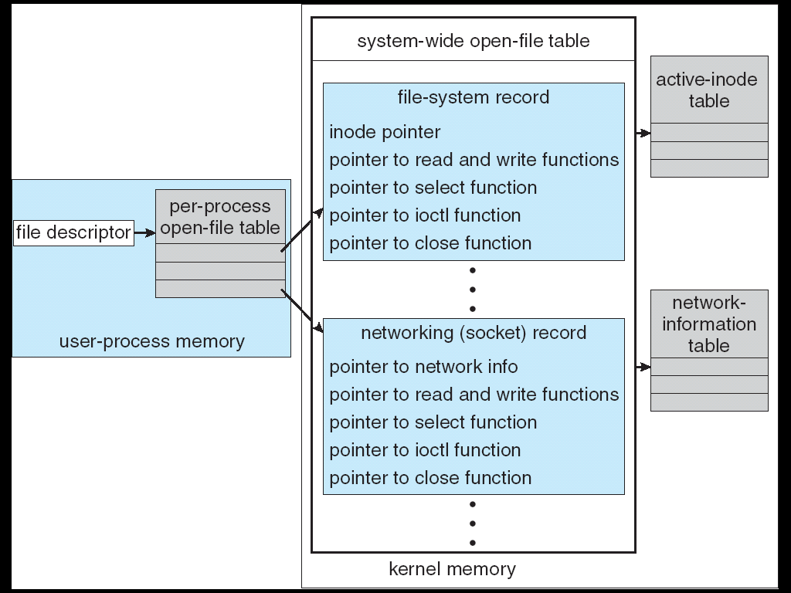
UNIX I/O Kernel Structure

Slide 20
Roadmap
Application I/O Interface
Kernel I/O Subsystem
Transforming I/O Requests to Hardware Operations
Performance

Slide 21
I/O Requests to Hardware Operations
Consider reading a file from disk for a process:
  Determine device holding file
  Translate name to device representation
  Physically read data from disk into buffer
  Make data available to requesting process
  Return control to process

Slide 22
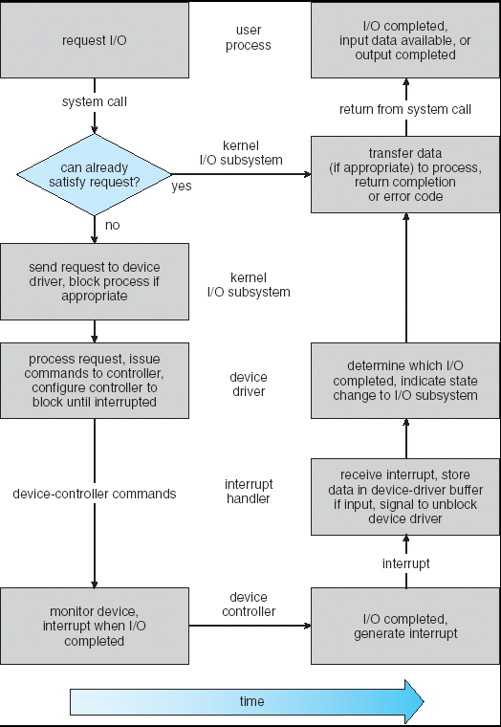
Life Cycle of An I/O Request

Slide 23
Roadmap
Application I/O Interface
Kernel I/O Subsystem
Transforming I/O Requests to Hardware Operations
Performance

Slide 24
Performance
I/O a major factor in system performance:
  Demands CPU to execute device driver, kernel I/O code
  Context switches due to interrupts
  Data copying
  Network traffic especially stressful

Slide 25
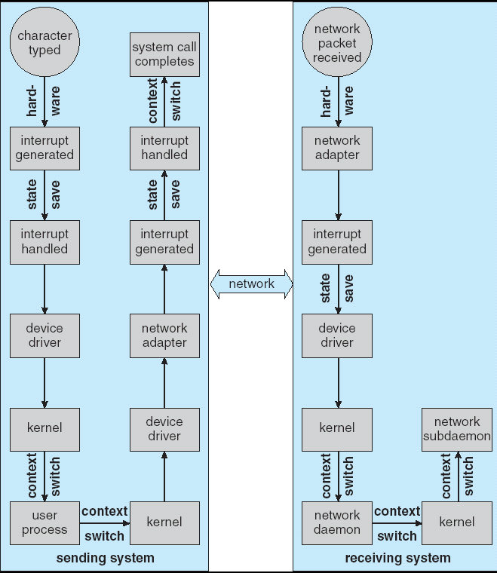
Intercomputer Communications

Slide 26
Improving Performance
Reduce number of context switches
Reduce data copying
Reduce interrupts by using large transfers, smart controllers, polling
DMA
Balance CPU, memory, bus, and I/O performance for highest throughput

Slide 27
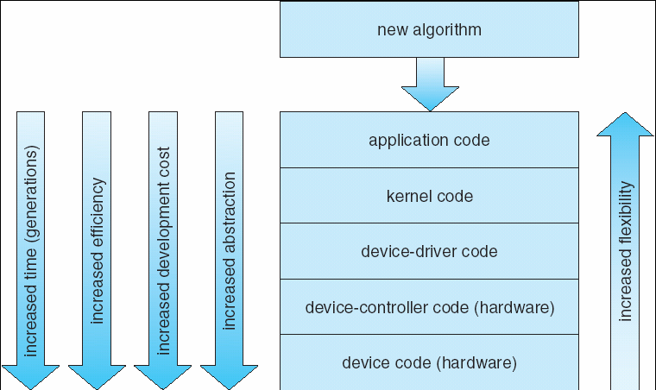
Device-Functionality Progression

Slide 28
Principles of
Operating System
End of I/O System

